Slide 1
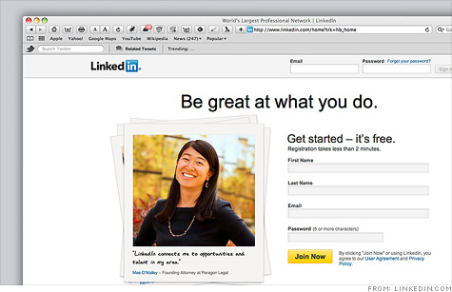

Slide 2













Problem
} Confidential data leaks from databases (DB)
} 2012: hackers extracted 6.5 million hashed passwords from the DB of LinkedIn
Threat: passive DB server attacks
User 1
DB Server
SQL
User 2
Application
User 3
System administrator
Hackers
} Process SQL queries on encrypted data

Slide 3


Slide 4
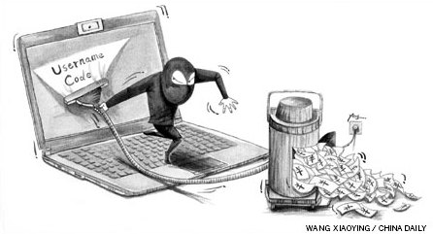

Slide 5
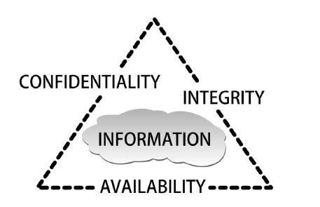
Figure 1-1 C.I.A. triangle
Courtesy Course Technology/Cengage Learning

Slide 6
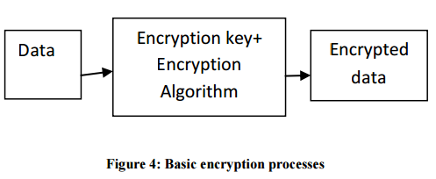

Slide 7
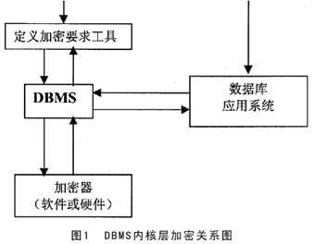

Slide 8
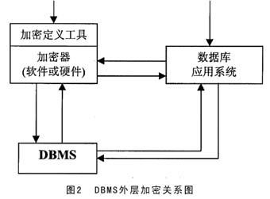

Slide 9
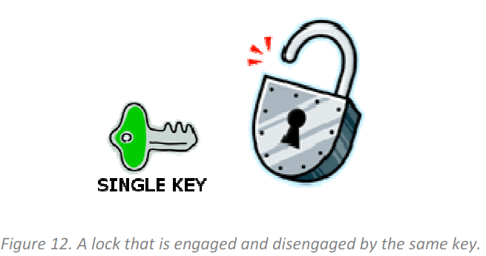
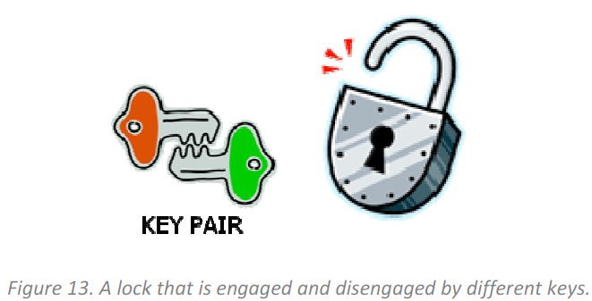
}

Slide 11
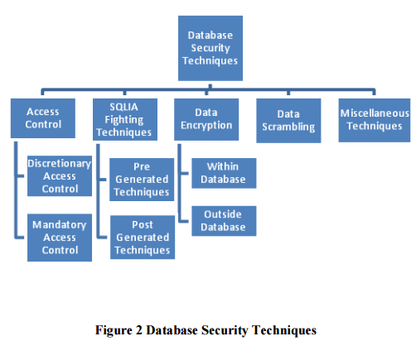

Slide 12
 | Data Encryption Within Database | Data Encryption Outside Database
Performer | DBMS | Specialized Encryption Server
Transparent Data encryption | Yes | No
Effect for Server’s Function | Affect | No
Encryption Key Management | Stored in database Big Risk | Special protection Small Risk
Effect for DBMS Function | No | Affect some functions (e.g. index)
Encryption Algorithm | Limit | Many

Slide 13
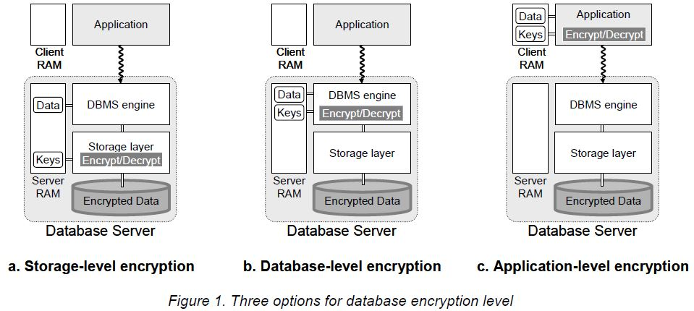

Slide 14
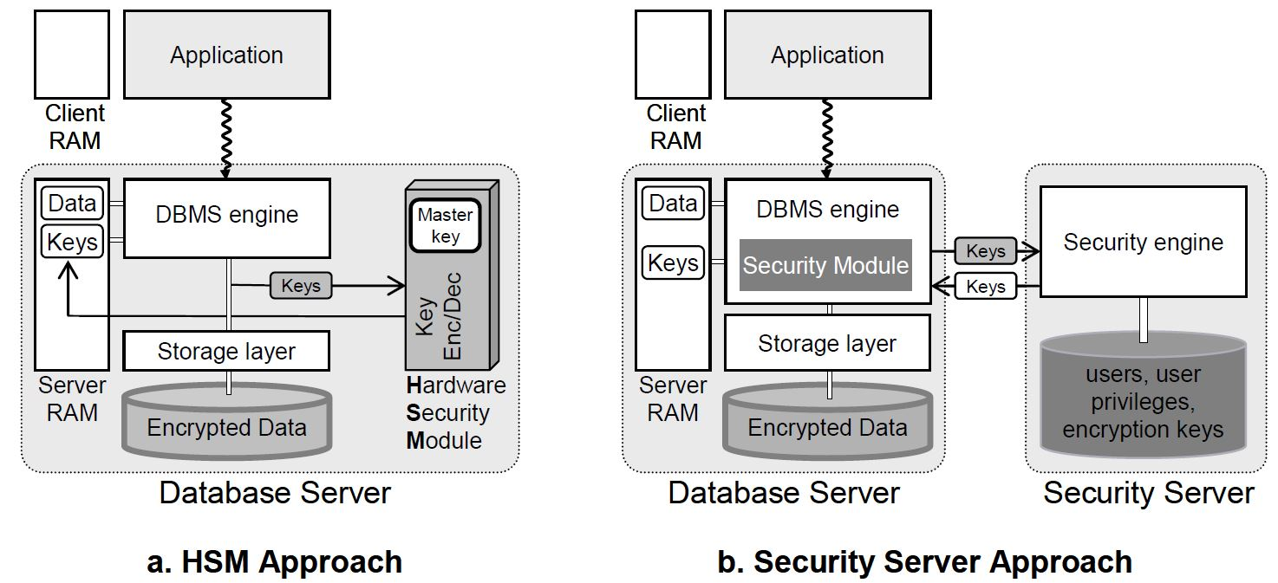

Slide 15

HSM

Slide 16
Standard encryption and hashing algorithms used by TDE

Slide 17
Managing and rotating TDE master keys using Oracle Enterprise Manager

Slide 18
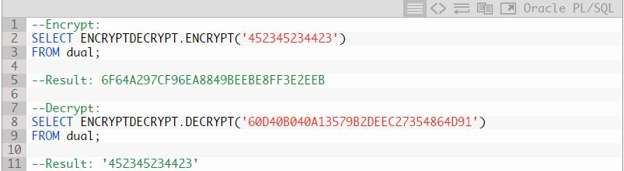

Slide 19
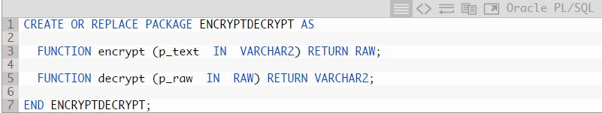

Slide 20
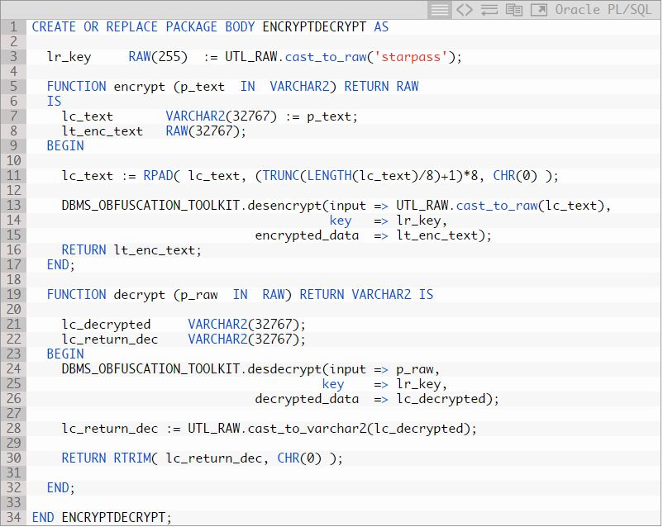

Slide 21
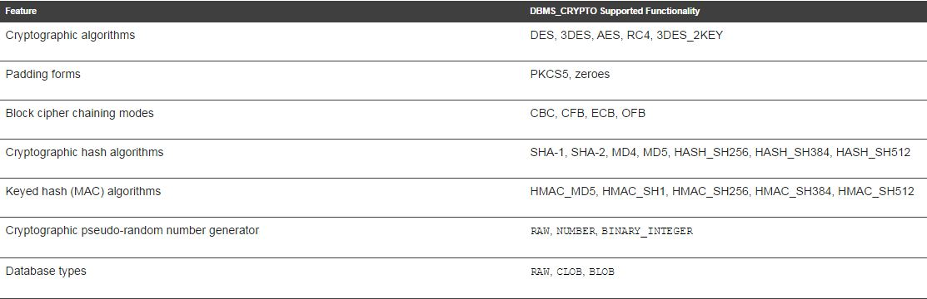
Table DBMS_CRYPTO Package Feature Summary

